Slide 1
MEAL CALORIE DETECTOR
BATCH-A5
INTERNAL GUIDE:
Mr. N. Venkateswarulu,
Assistant Professor,
Department of CSE.
Shivani Cherukupalli 22251A0506
Sreenidhi Gajam 22251A0509
Soumya Priya Hunda 22251A0543
Nikhila Nallaganti 22251A0558

Slide 2
INTRODUCTION
Managing dietary habits and tracking daily calorie intake can be a complex and time-consuming process. Many individuals struggle to assess the nutritional value of their meals accurately.
Hence, there is a growing need for a more accessible, efficient, and user-friendly solution to help individuals monitor their food intake and make healthier dietary choices.
This project addresses this growing demand by introducing a system capable of automatically identifying and categorizing food items from images and estimating their calorie content.
By simplifying dietary tracking, this solution empowers users to take control of their health, make better dietary decisions, and enhance their overall well-being.

Slide 3
LITERATURE SURVEY
SNo | Research Paper Title, Author Names, Year of Publications. | Journal Name | Algorithm | Advantage | Limitation
1 | CaLoRAify: Calorie Estimation with Visual-Text Pairing and LoRA-Driven Vision-Language Models), Dongyu Yao.,et al,2024. | arXiv | LoRA, RAG , Vision-Language Model (VLM) | High accuracy in calorie and nutrition prediction from images. | Needs good image quality , May struggle with mixed or composite dishes in complex plates.
2 | An Evaluation of ChatGPT for Nutrient Content Estimation from Meal Photographs, Jared M., et al,2025 | Nutrients | GPT-4 (Multimodal Model by OpenAI) | Multi-nutrient Awareness. Ease of Use. | Portion Estimation Inaccuracy, Hidden Ingredients Not Detected.
3 | NutriGen: Personalized Meal Plan Generator Leveraging Large Language Models to Enhance Dietary and Nutritional Adherence.Andong Hua., (2025) | arXiv | GPT-4o-mini | Uses accurate nutrition data from reliable sources (USDA) | Not 100% accurate in predicting portion sizes.
4

Slide 4
EXISTING SYSTEM
1. Manual Diet Tracking Apps - MyFitnessPal, Lose It!, Cronometer
Users log food by searching in a database.
Customizable portions, but time-consuming and prone to human error.
2. Barcode Scanning -MyFitnessPal, Fooducate, YukaInstantly
It fetches nutrition information by scanning barcodes.
It only works great for packaged foods, but not for homemade or fresh meals.
3. Pre-Trained Deep Learning Models - Google Im2Calories, CNN-based models
It recognizes food from images using CNNs.
Fast and automated, but struggles with complex or unfamiliar dishes.
4. AI-Powered Food Recognition Tools - Calorie Mama AI, Apple Health AI
It detects multiple food items in one image.
It provides detailed analysis, but needs high processing power and may face privacy concerns.

Slide 5
DRAWBACKS OF EXISTING SYSTEM
Limited Dataset Coverage
Underrepresentation of Global Cuisines - Existing datasets mostly include Western foods, leading to poor recognition of regional or traditional dishes like dhokla, injera, or balut.
Inadequate Handling of Recipe Variations - Dishes prepared differently (e.g., plain rice vs. fried rice) confuse models due to limited examples of such variants in training data.
Inability to Recognize Multiple Food Items
Overlapping and Mixed Food Challenges - AI struggles to distinguish between visually overlapping foods or mixed dishes like casseroles and stews.
Lack of Contextual Understanding - Models fail to differentiate key ingredients or sauces (e.g., Alfredo vs. marinara), leading to incorrect calorie estimation.
High Computational Cost
Hardware Limitations for End Users - Advanced models often require high-end GPUs or cloud services, making them inaccessible on regular smartphones.
Latency Affects Real - Time UseSlow processing delays responses, which diminishes user experience in fast-paced or mobile scenarios.

Slide 6
PROPOSED SYSTEM
The proposed system offers an efficient and accurate method for estimating the nutritional value of food using image recognition.
The system identifies and classifies food items from uploaded images.
It then calculates the total calorie content and other nutritional values by matching detected items with a nutritional data.
Designed for ease of use and high accuracy, this solution provides real-time feedback, enabling users to conveniently track their meals and make informed dietary choices.

Slide 7
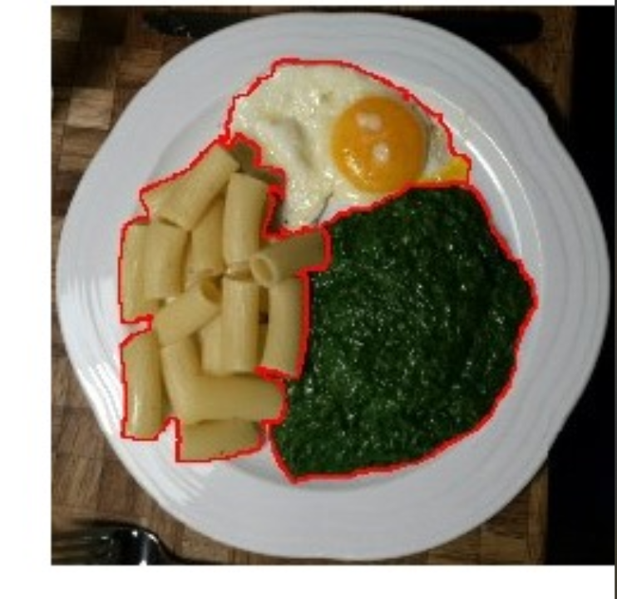
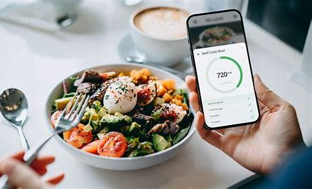
PROBLEM STATEMENT
With the rising incidence of lifestyle-related diseases due to poor dietary habits, there is a growing need for effective tools to monitor food intake. This project aims to develop an AI-powered system that analyzes food images to identify items and estimate their calorie content, including calories, protein, fat, and carbohydrates. Using AI model and image recognition, this tool promotes healthier eating habits and supports individuals and healthcare professionals in tracking nutrition and calories effortlessly.

Slide 8
OBJECTIVES
To develop a system capable of detecting food items from an image.
To estimate calories, protein, fats, and carbohydrates for detected food item.
To enable the recognition of multiple food items within a single image.
To provide a user-friendly web interface for seamless user interaction which includes Image Upload, Real-Time Detection, Nutritional Information Display.

Slide 9
METHDOLOGY
Initial Approach Using Machine Learning:
Started by selecting the UEC FOOD 256 dataset, which contains images of over 256 different food items.
Split the dataset into training and testing sets and used traditional machine learning and deep learning techniques to classify food items in images.
Faced major challenges with system performance, lacked the computational power needed to train large models effectively, which led to very slow training times. The model's accuracy was quite low.
Switch to Pre-trained Model:
To overcome the issues with the custom model, decided to use YOLOv5, a popular object detection model that comes pre-trained on the COCO dataset.
Using YOLOv5, able to quickly detect food items in uploaded images.

Slide 10
Used a manually created dictionary to map the detected item to its calorie content. This allowed to calculate the calories of the meal.
COCO dataset only includes around 10–15 common food items. This limited the model’s ability to recognize a wider variety of dishes.
Final Integration with GPT-4o Mini:
To address the limitations of both the custom model and YOLOv5, explored a more advanced approach using the GPT-4o Mini model, which can process both images and text.
Able to directly upload an image, and the model would identify multiple food items present in the image with high accuracy.
Then used a nutrition mapping system to fetch the calories, fat, and carbohydrate content for each identified food item. This method eliminated the need for separate training and allowed us to handle a wider range of food categories, including regional and mixed dishes as it is an AI model.

Slide 11
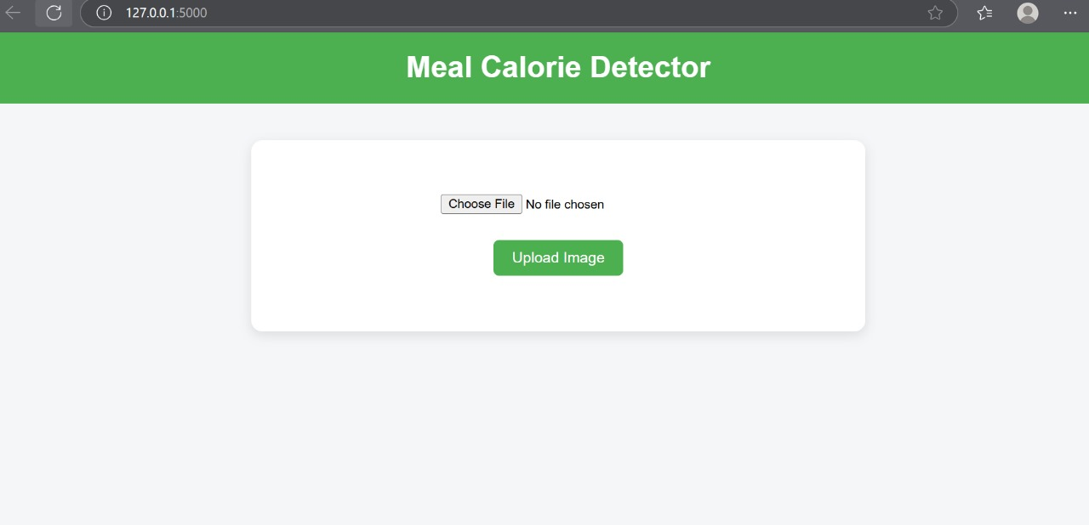
RESULTS
The results of meal calorie detector with YOLO v5 model.
Fig 1: Home page where the user can upload an image of meal plate.

Slide 12
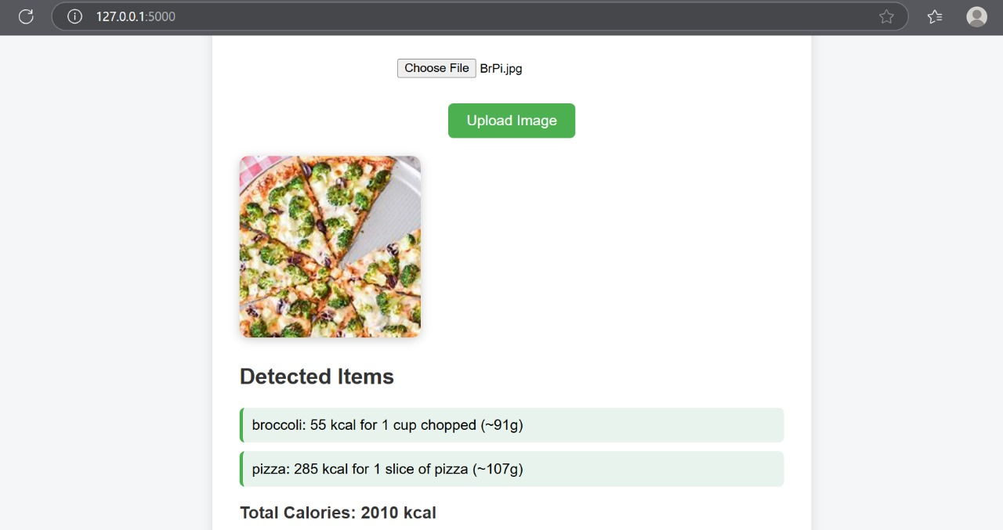
The image is analysed and the items are detected to give the final calorie content of the meal plate.
Fig 2: The calorie content display after analysis of image

Slide 13
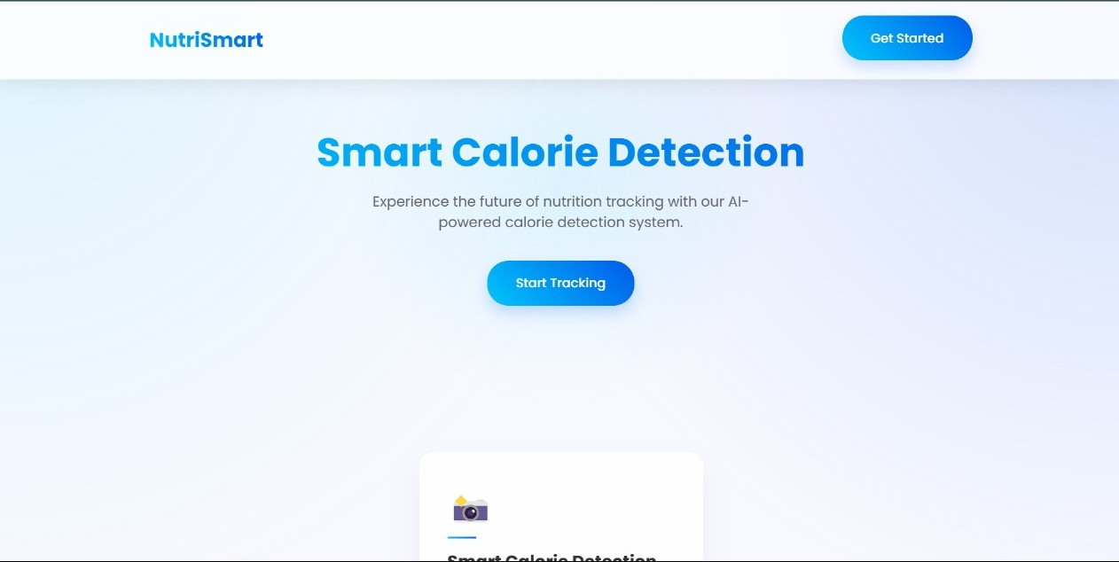
The Meal Calorie Detector accurately recognized multiple food items from a single image and provided real-time nutritional estimates using GPT-4o-mini.
Fig 3: It is a web application ,allows users to upload a food image for analysis by clicking on “Start tracking”.

Slide 14
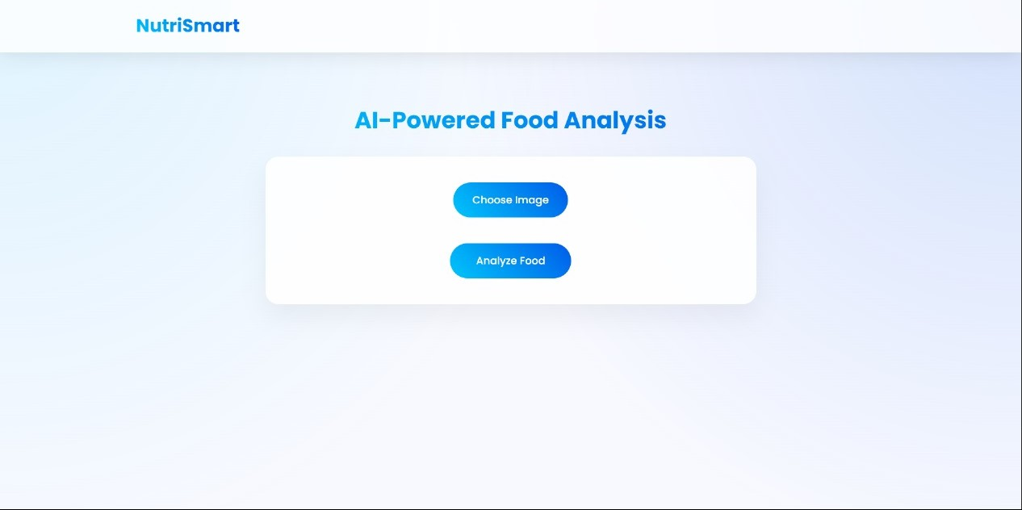
Fig 4: Now user selects a food image from their device for upload.

Slide 15
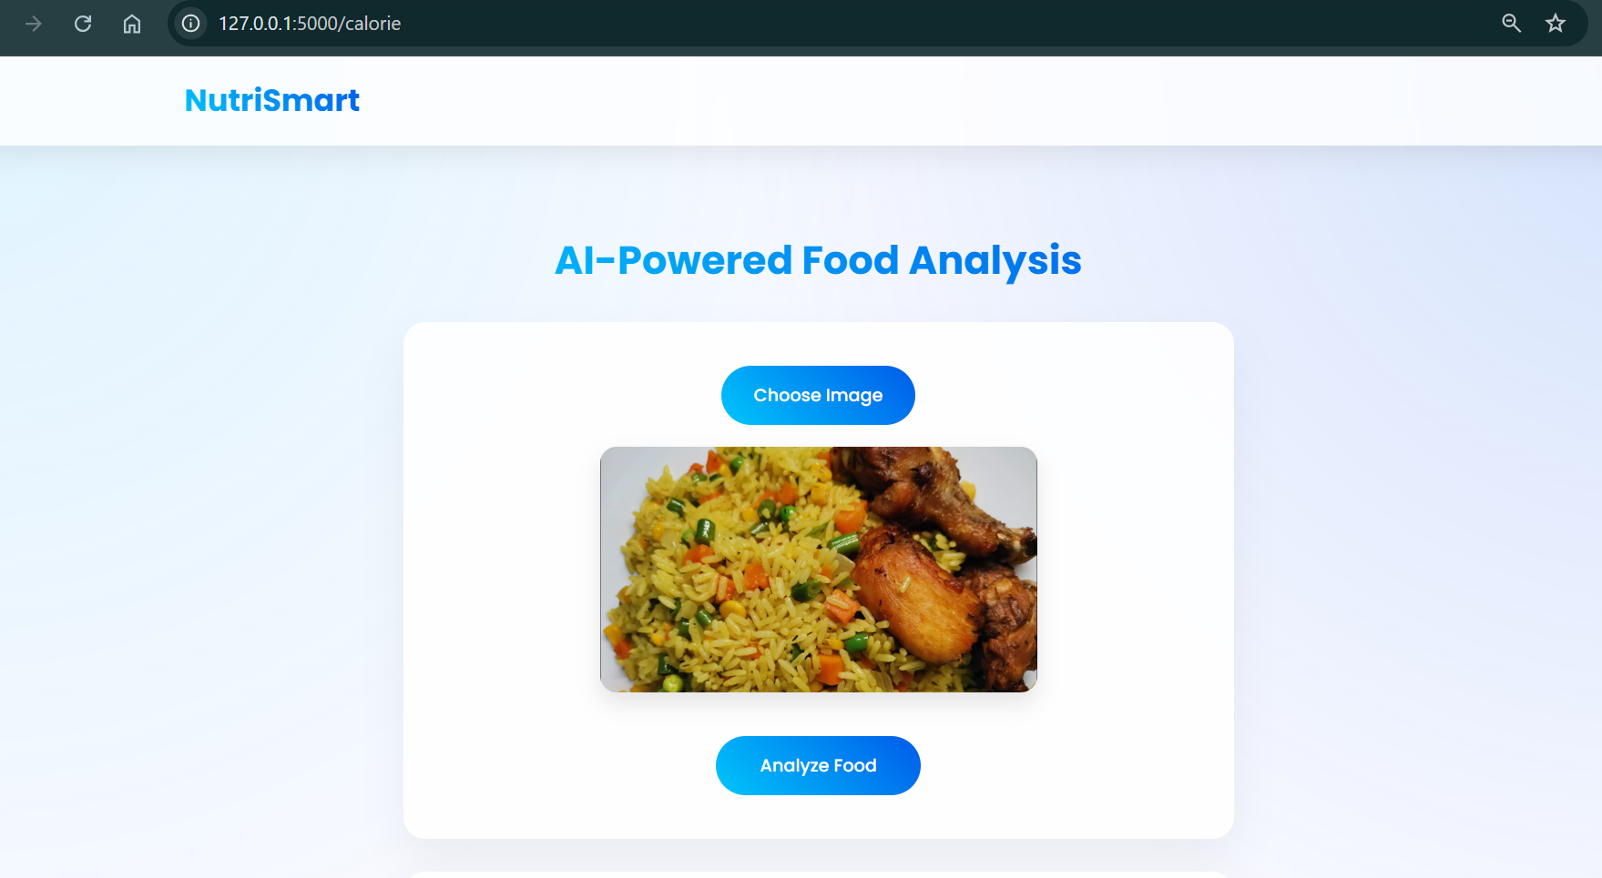
Fig 5: Click on “Analyse” button, ready to process the uploaded image

Slide 16
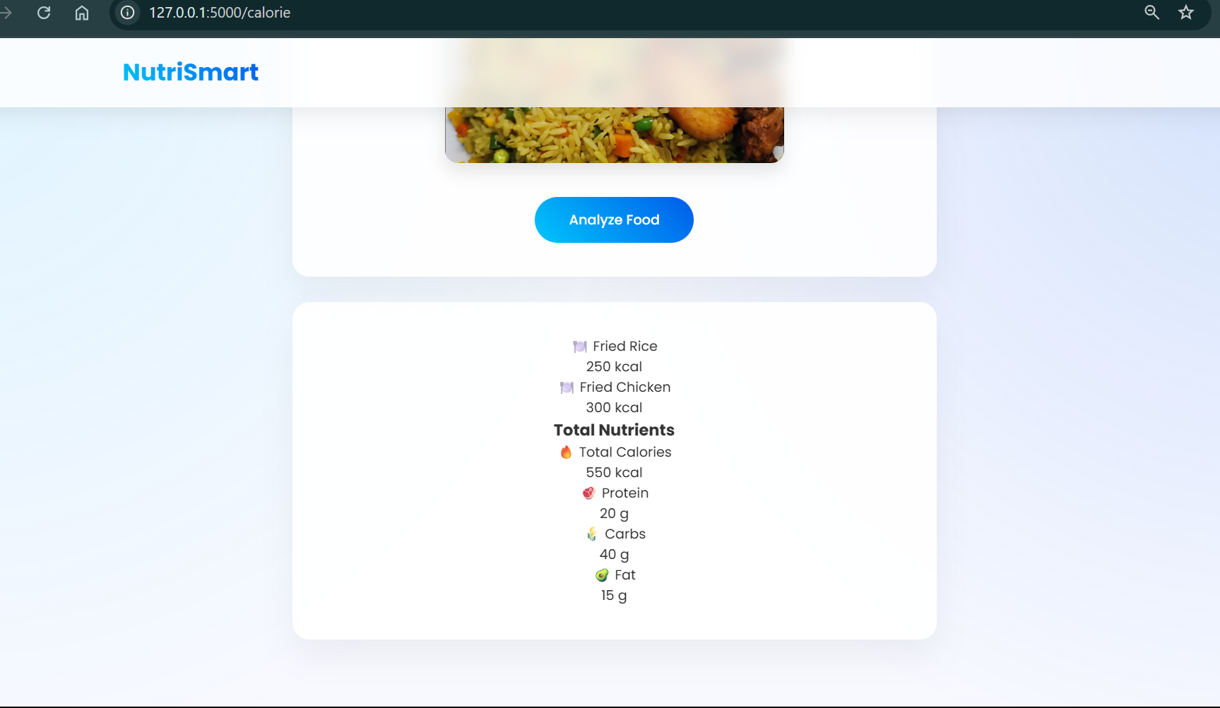
Fig 6: Nutritional breakdown and calorie count are displayed after analysis.

Slide 17
CONCLUSIONS
This project successfully developed an AI-based solution that simplifies dietary tracking through automated food recognition and nutritional analysis. It reduces the need for manual input, minimizes human error, and promotes healthier eating habits. With its user-friendly interface and accurate results, the system provides a practical tool for everyday health and wellness management.

Slide 18
FUTURE SCOPE
Develop a mobile app for better accessibility.
Integrate Augmented Reality (AR) for real-time calorie overlays.
Expand food database to support regional and homemade dishes.
Improve portion size estimation using depth sensing. Connect with fitness apps and wearables for complete health tracking.
Adding food recommendation feature based on persons health.

Slide 19
THANK YOU

